Slide 1
AIRFRAME TEAM WEEK 9 PROGRESS REPORT
08-06-2023

Slide 2
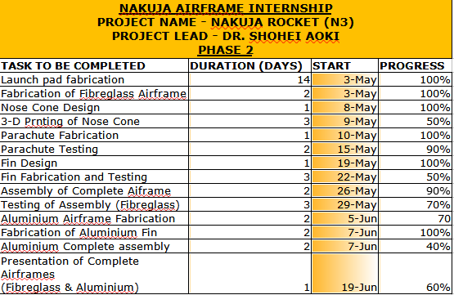

Slide 3
secondary objectives
Primary objective
Fabrication and placement of fiber glass fin
Fabrication of aluminum fin
Parachute test
Completion of fiber glass airframe
Completion of aluminum airframe

Slide 4
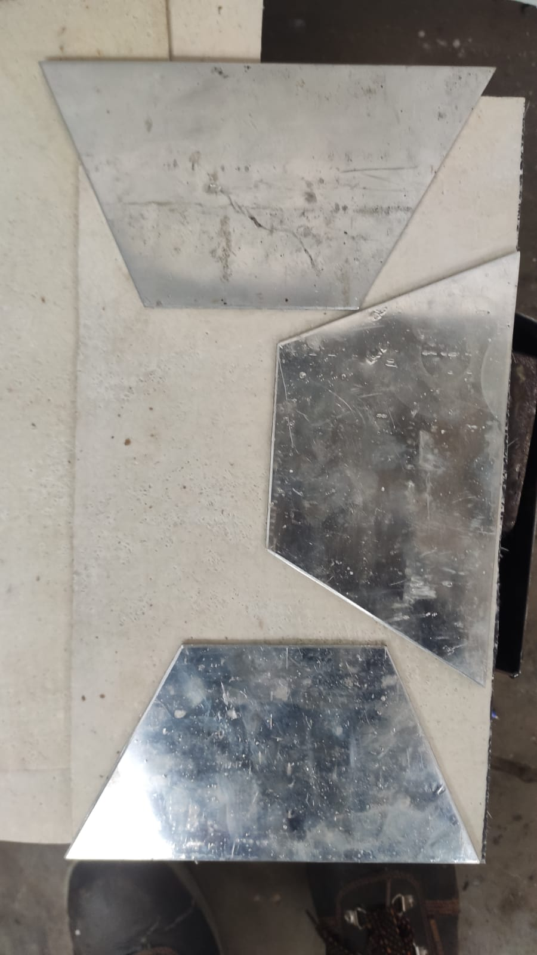
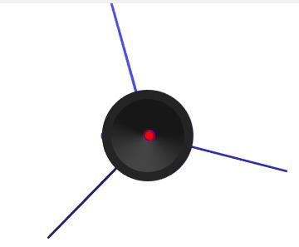
Fabrication and design of aluminum fin

Slide 5
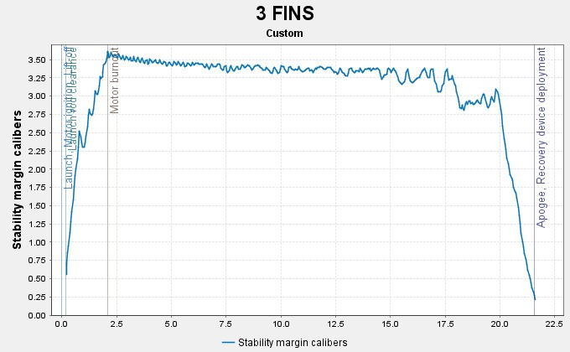
Aluminum Fin simulations

Slide 6
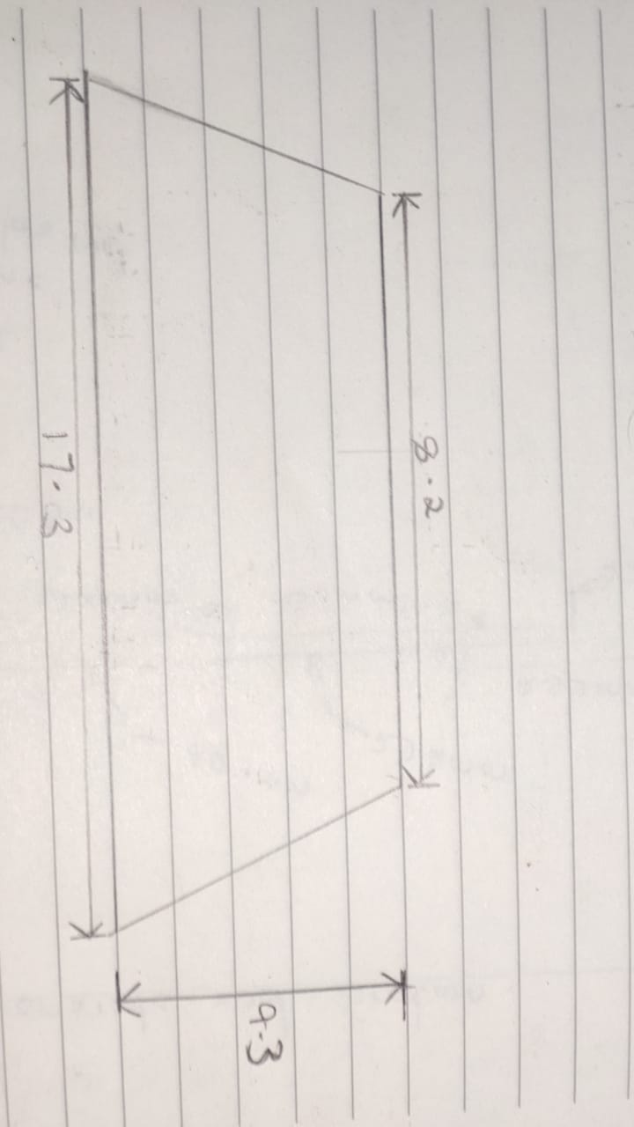
Design process
We ran simulations on open rocket software
The final fin design was the trapezoidal section shown

Slide 7
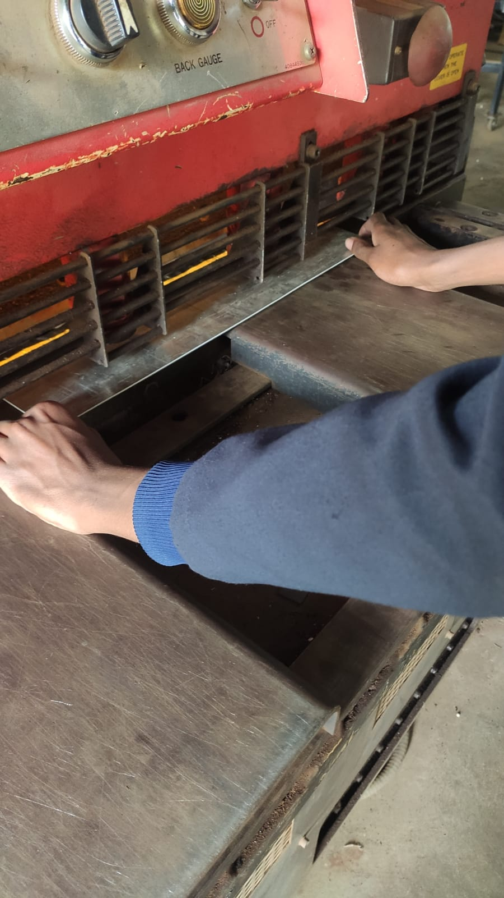
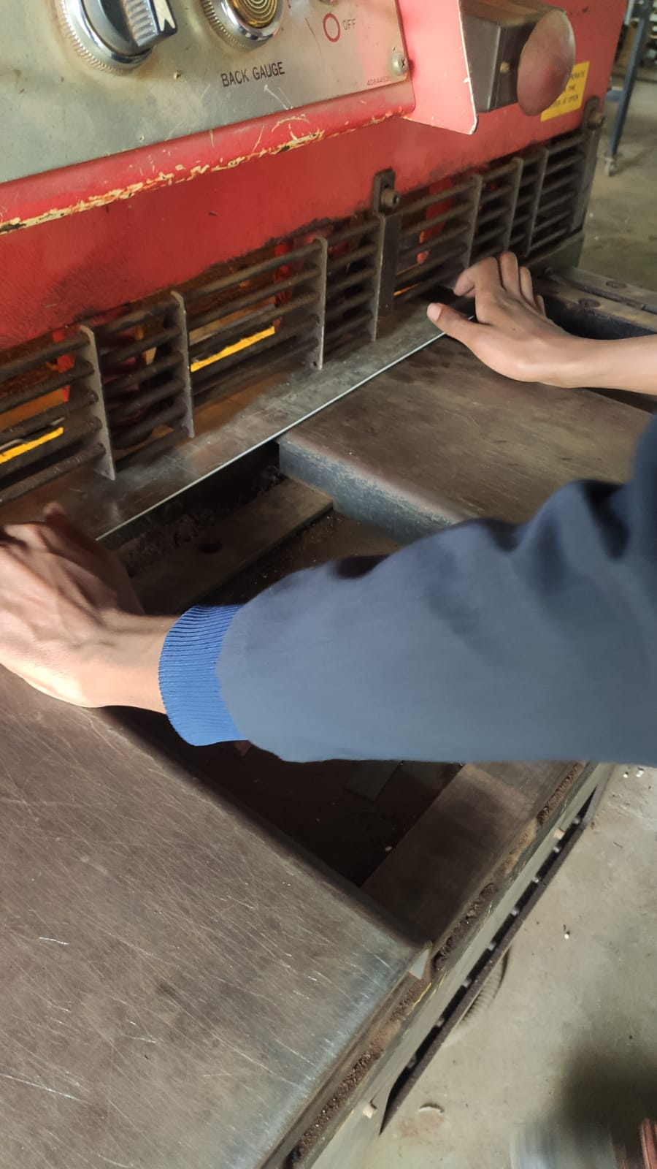
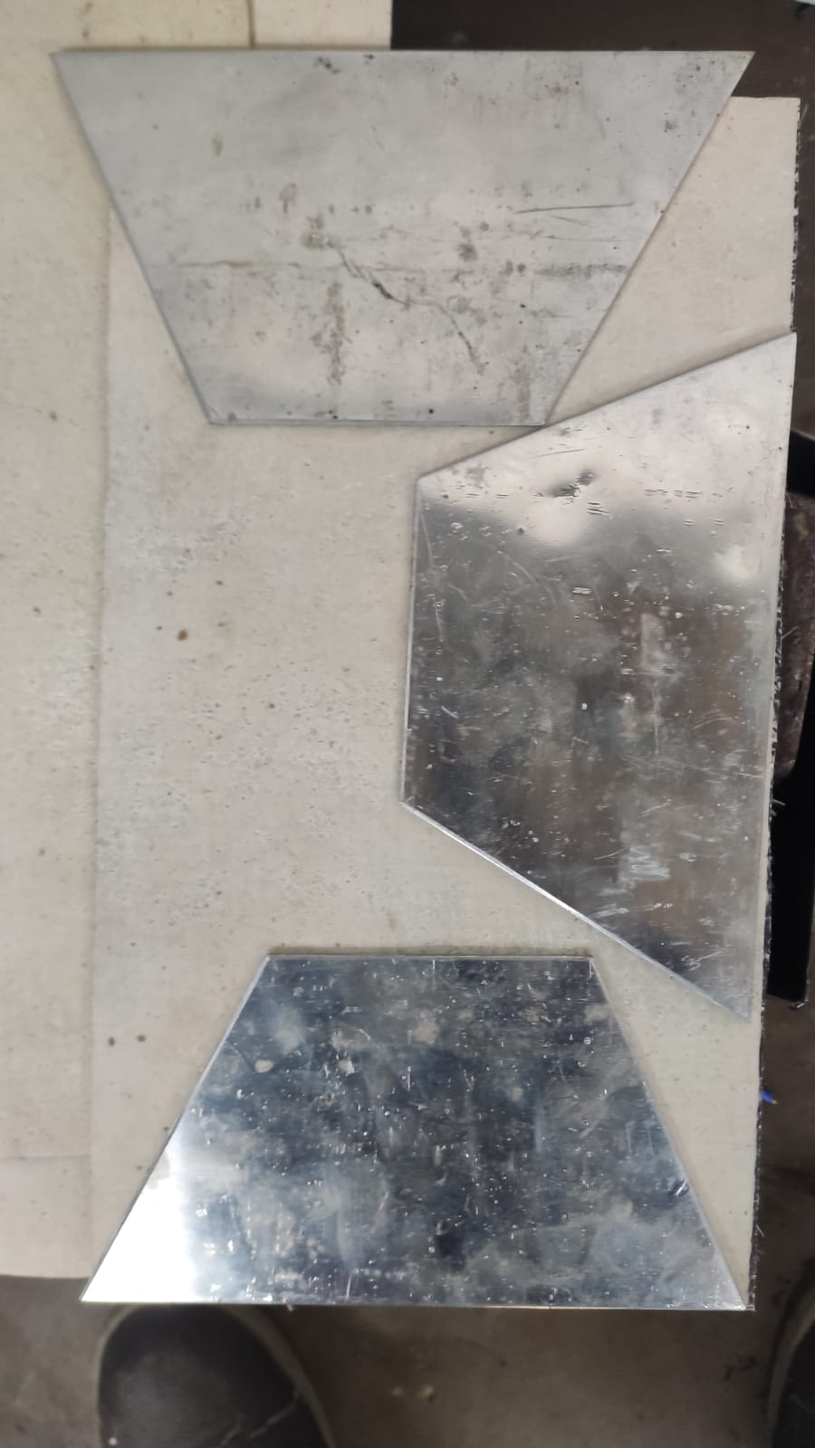
Fin cutting
Cut fins

Slide 8
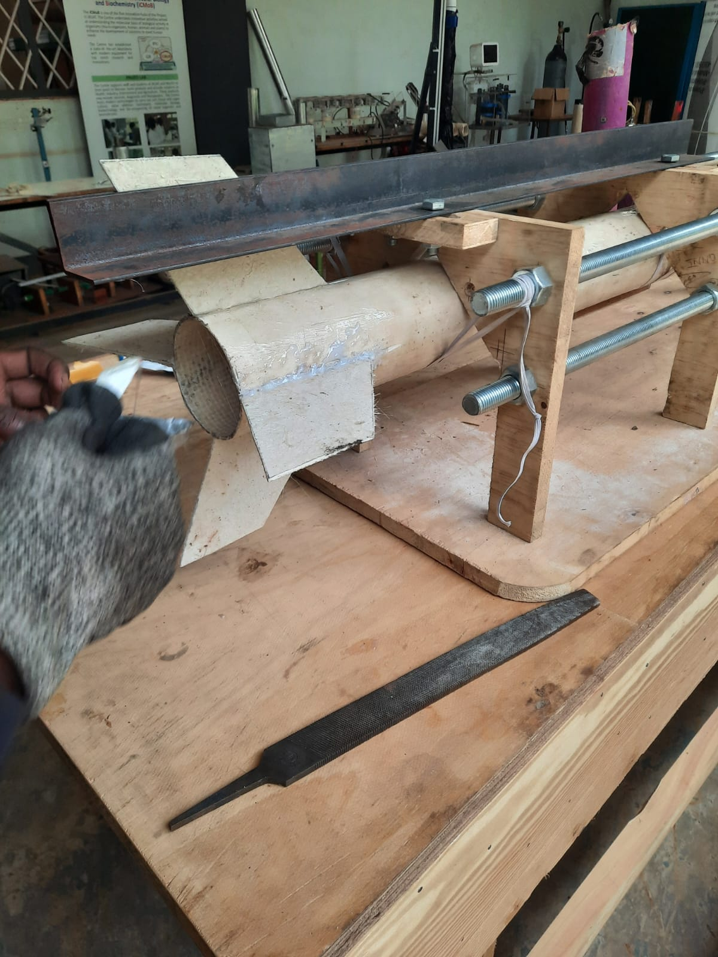
Fabrication and placement of fiber glass fin

Slide 9
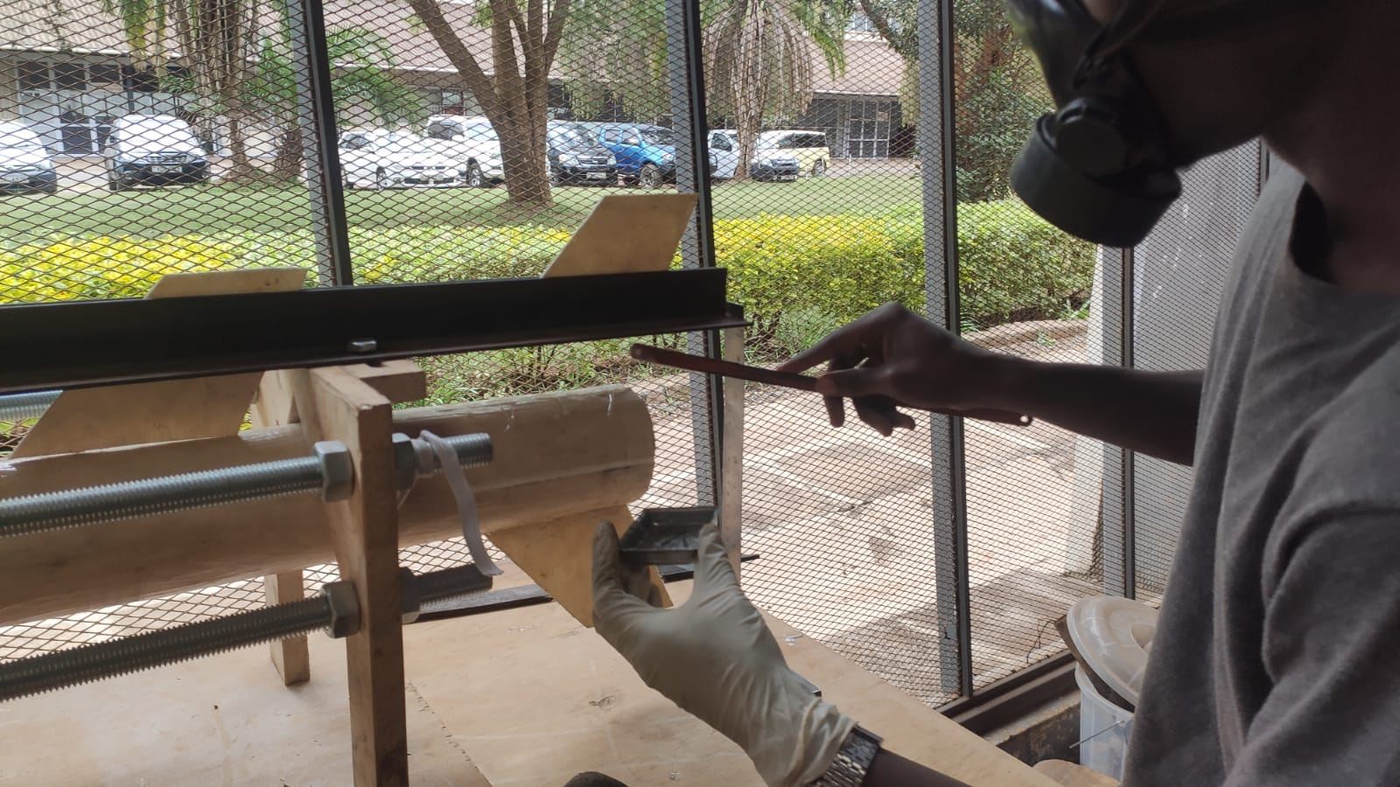
Fin placing process
1mm groves were made on the fiber glass frame
The airframe is placed on the alignment jig

Slide 10
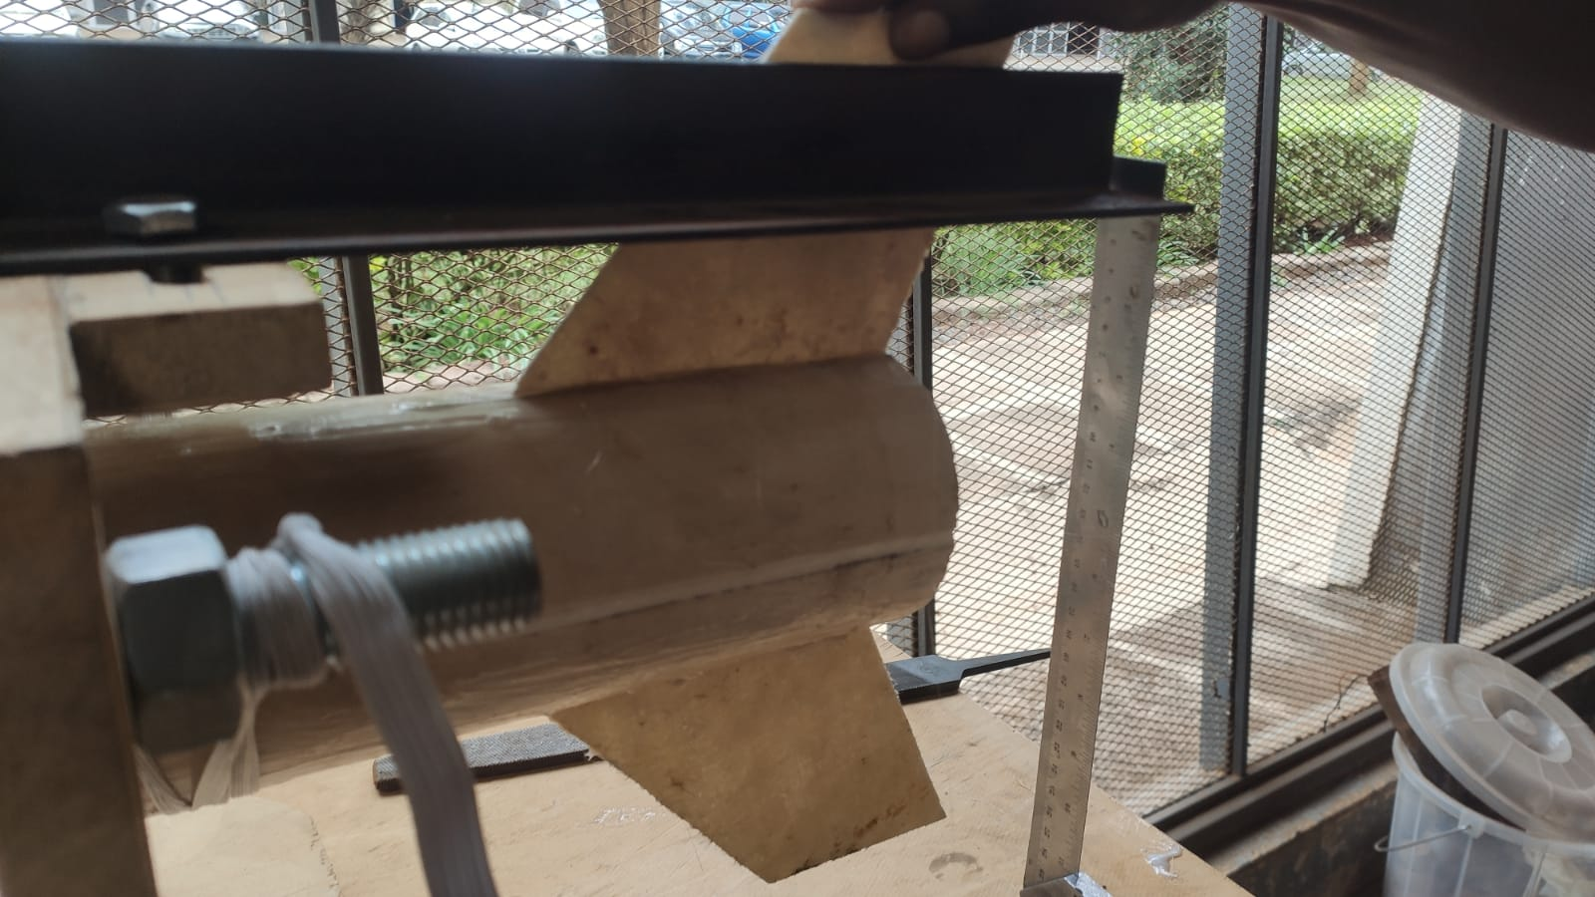
3. The fin is placed to ensure proper alignment

Slide 11
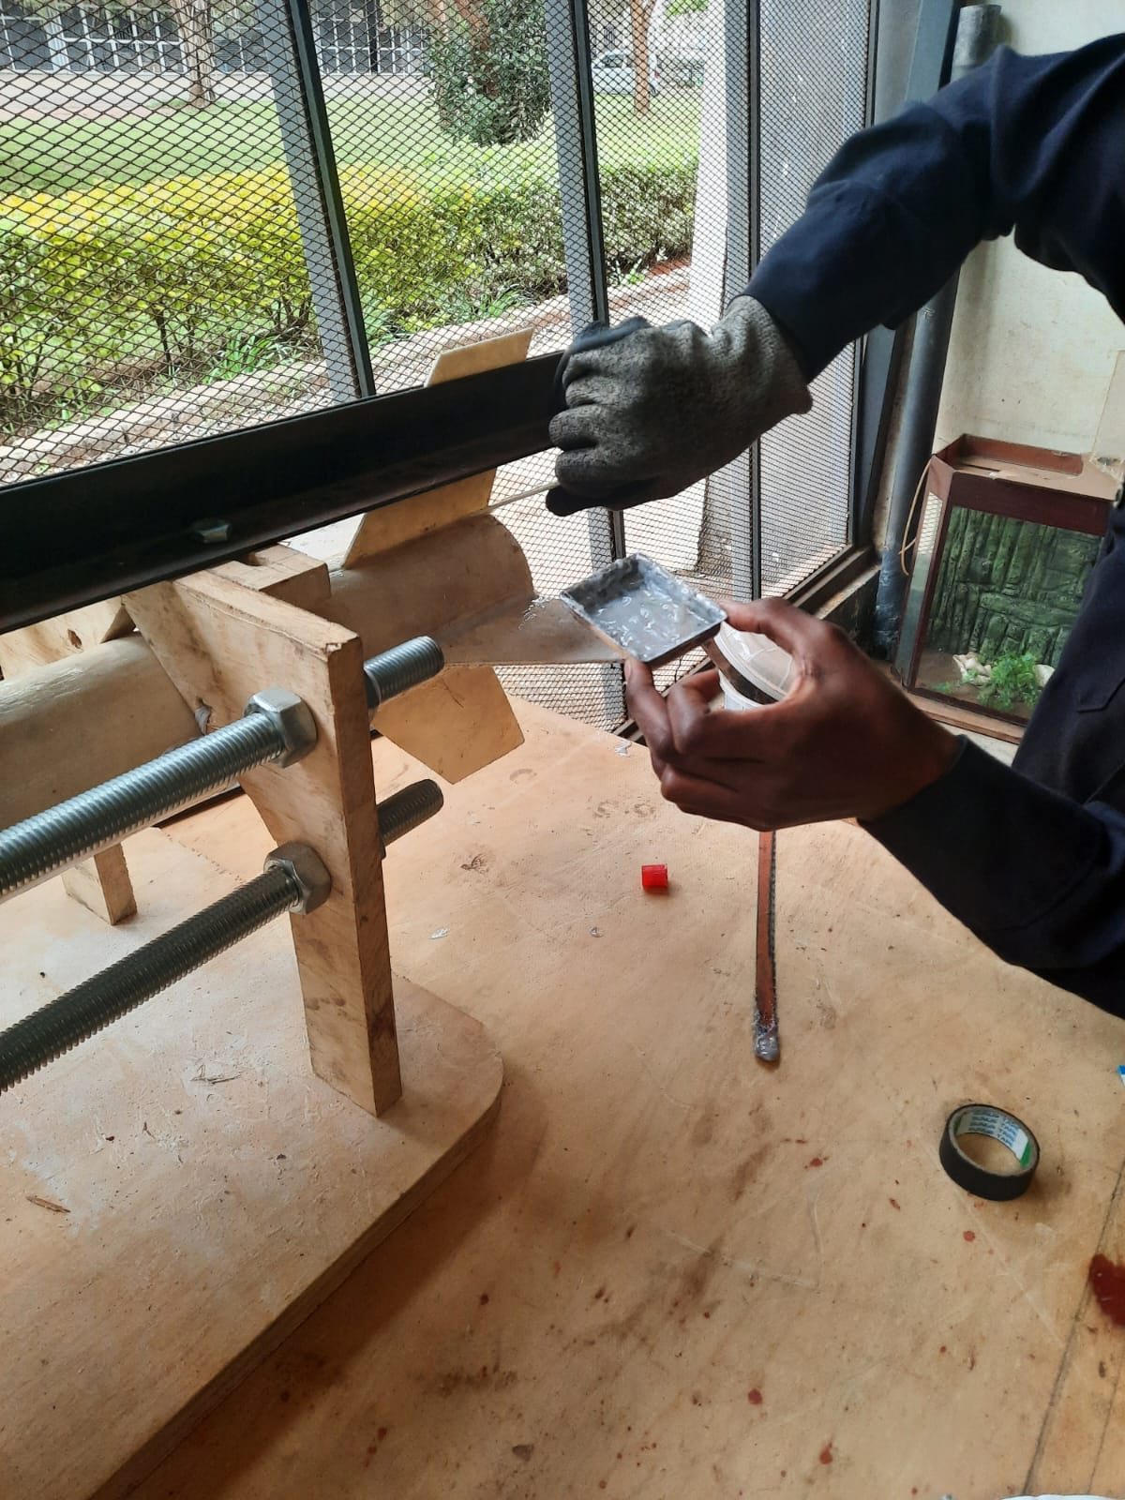
4.Glue is then applied on the slots and the fin is placed
5. The glue is allowed to set for 30minutes

Slide 12
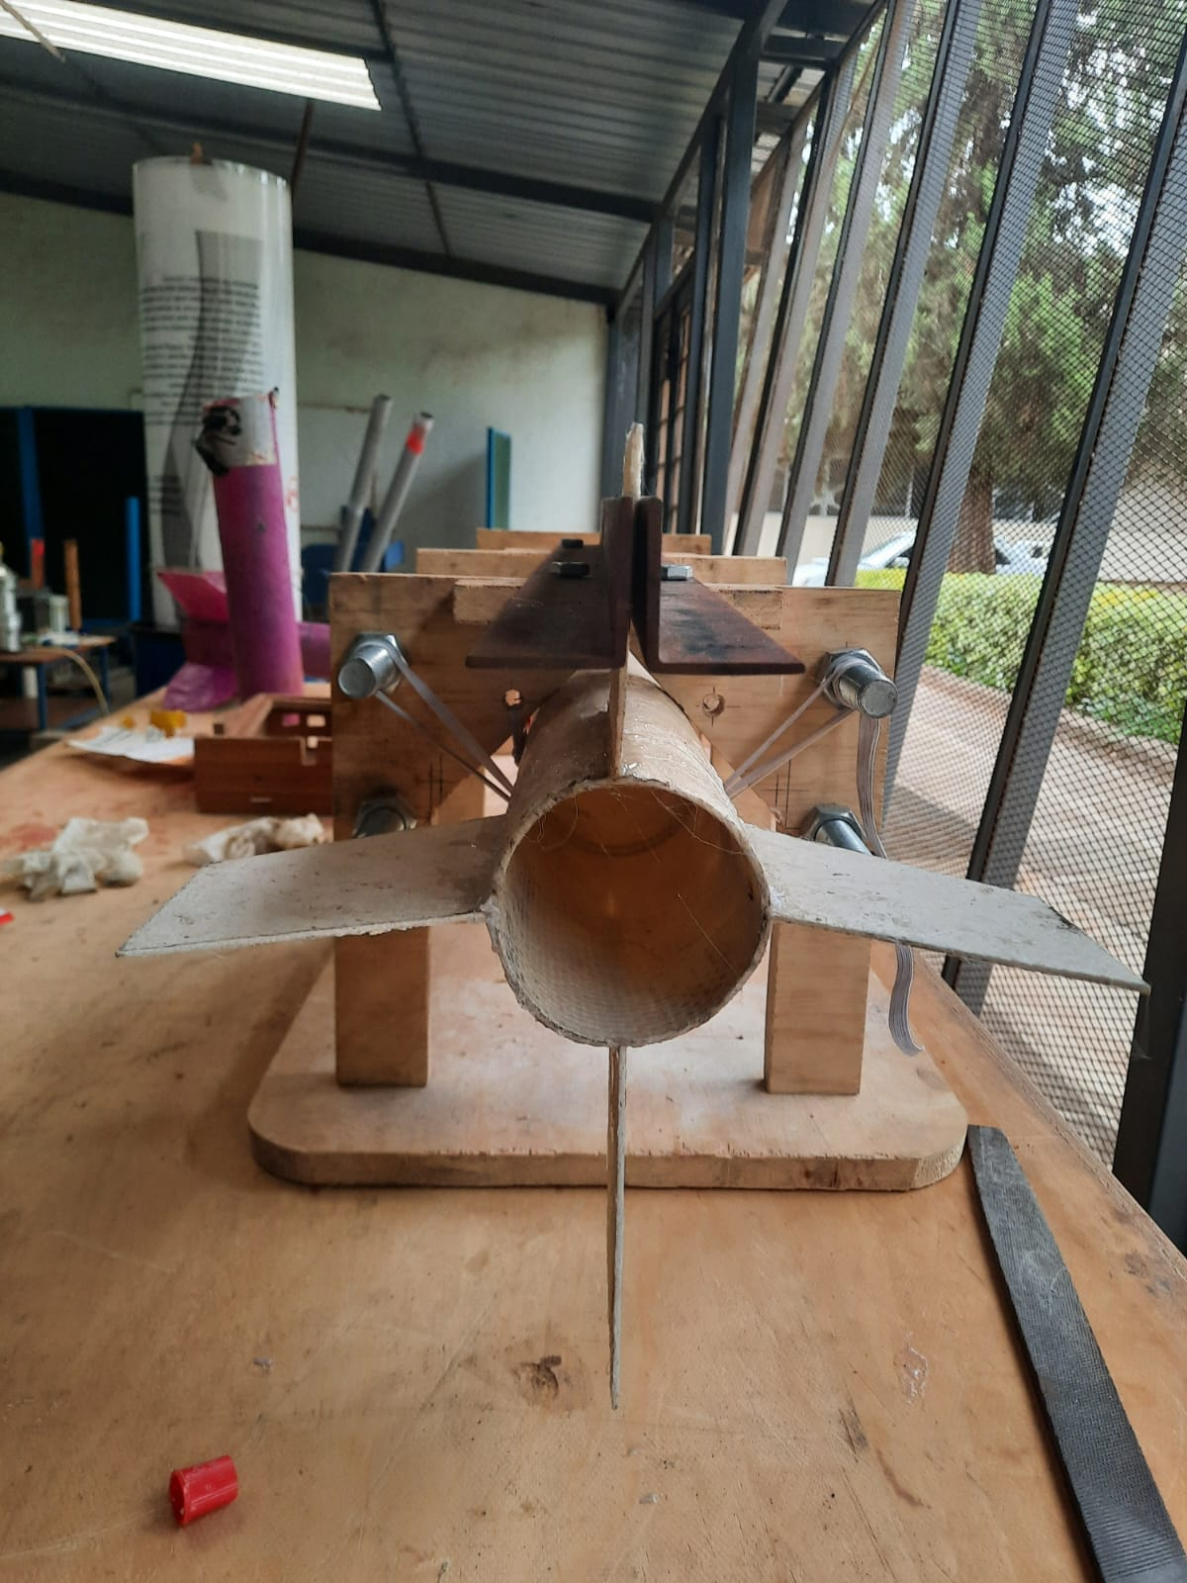
Fiber glass frame with all fins placed

Slide 13
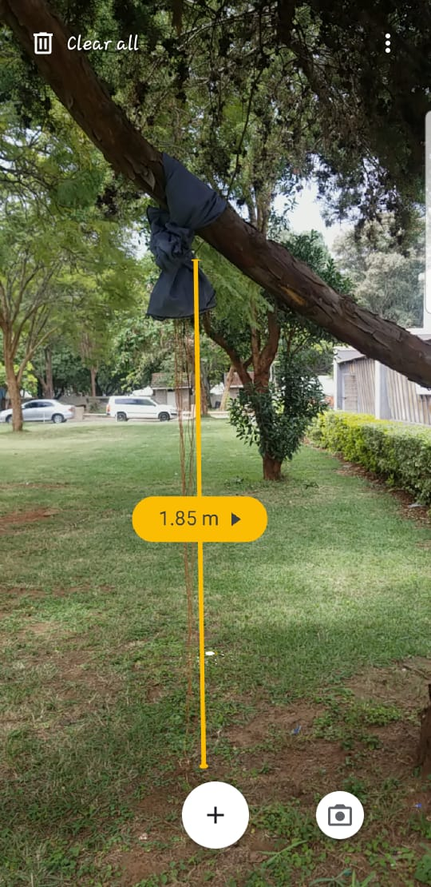
Parachute shock cord test
Various loads were applied to the parachute to simulate the instantaneous load experienced on the shock cord during deployment
Objectives
To determine the strength of the shroud lines under loading.
To determine whether the parachute can withstand the weight of the rocket.

Slide 14
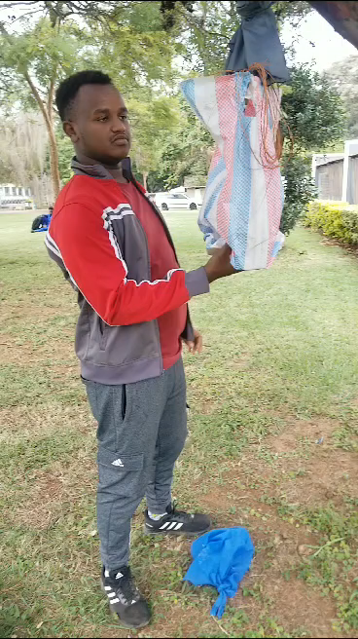
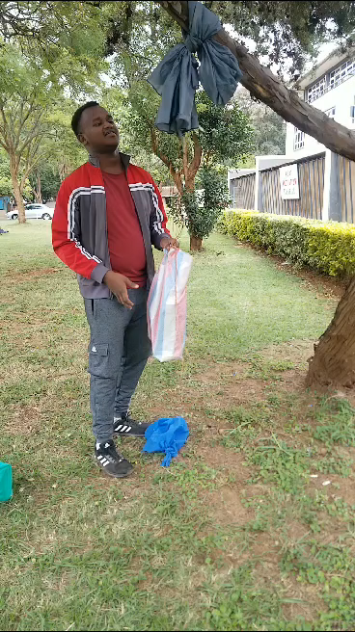
2.5kg
5kg

Slide 15
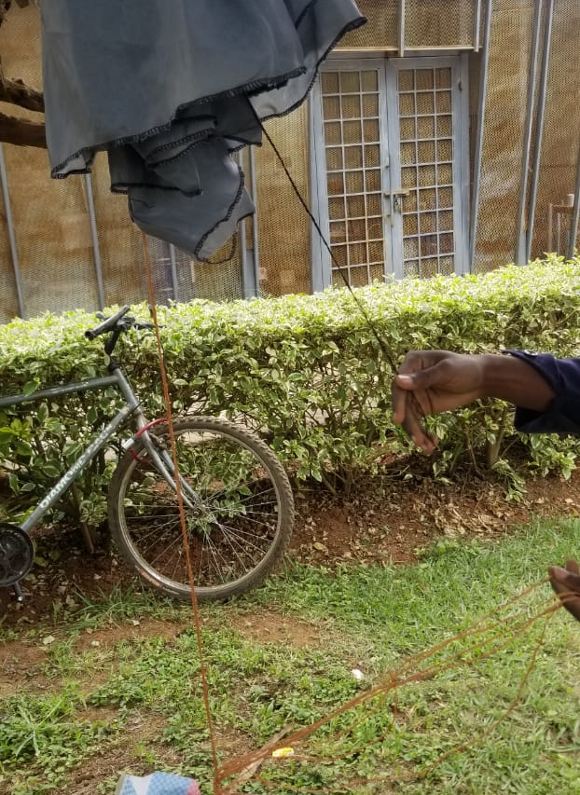
observations
For the 2.5kg load no damage incurred
For 5kg load structural damage was incurred
Conclusion
The attachment of the shroud lines to the parachute was insufficient to hold the weight of the rocket. The line should be reinforced further.

Slide 16
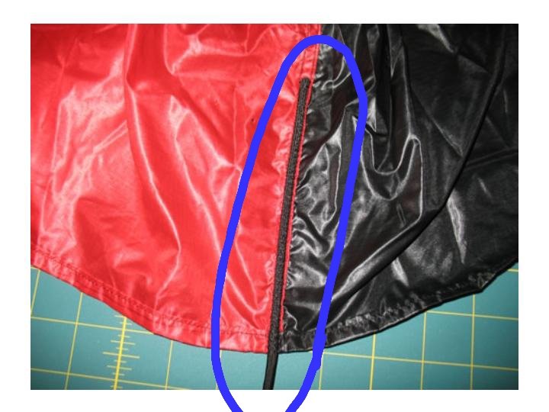
Solution
Revamping the shroud line attachment so that it can be stronger (currently under fabrication)

Slide 17
Next week's objectives
Aluminum fin attachment
Structural testing of aluminum airframe
Structural testing of fiber glass airframe
Motor mount purchasing

Slide 18
Thank you

